Slide 1
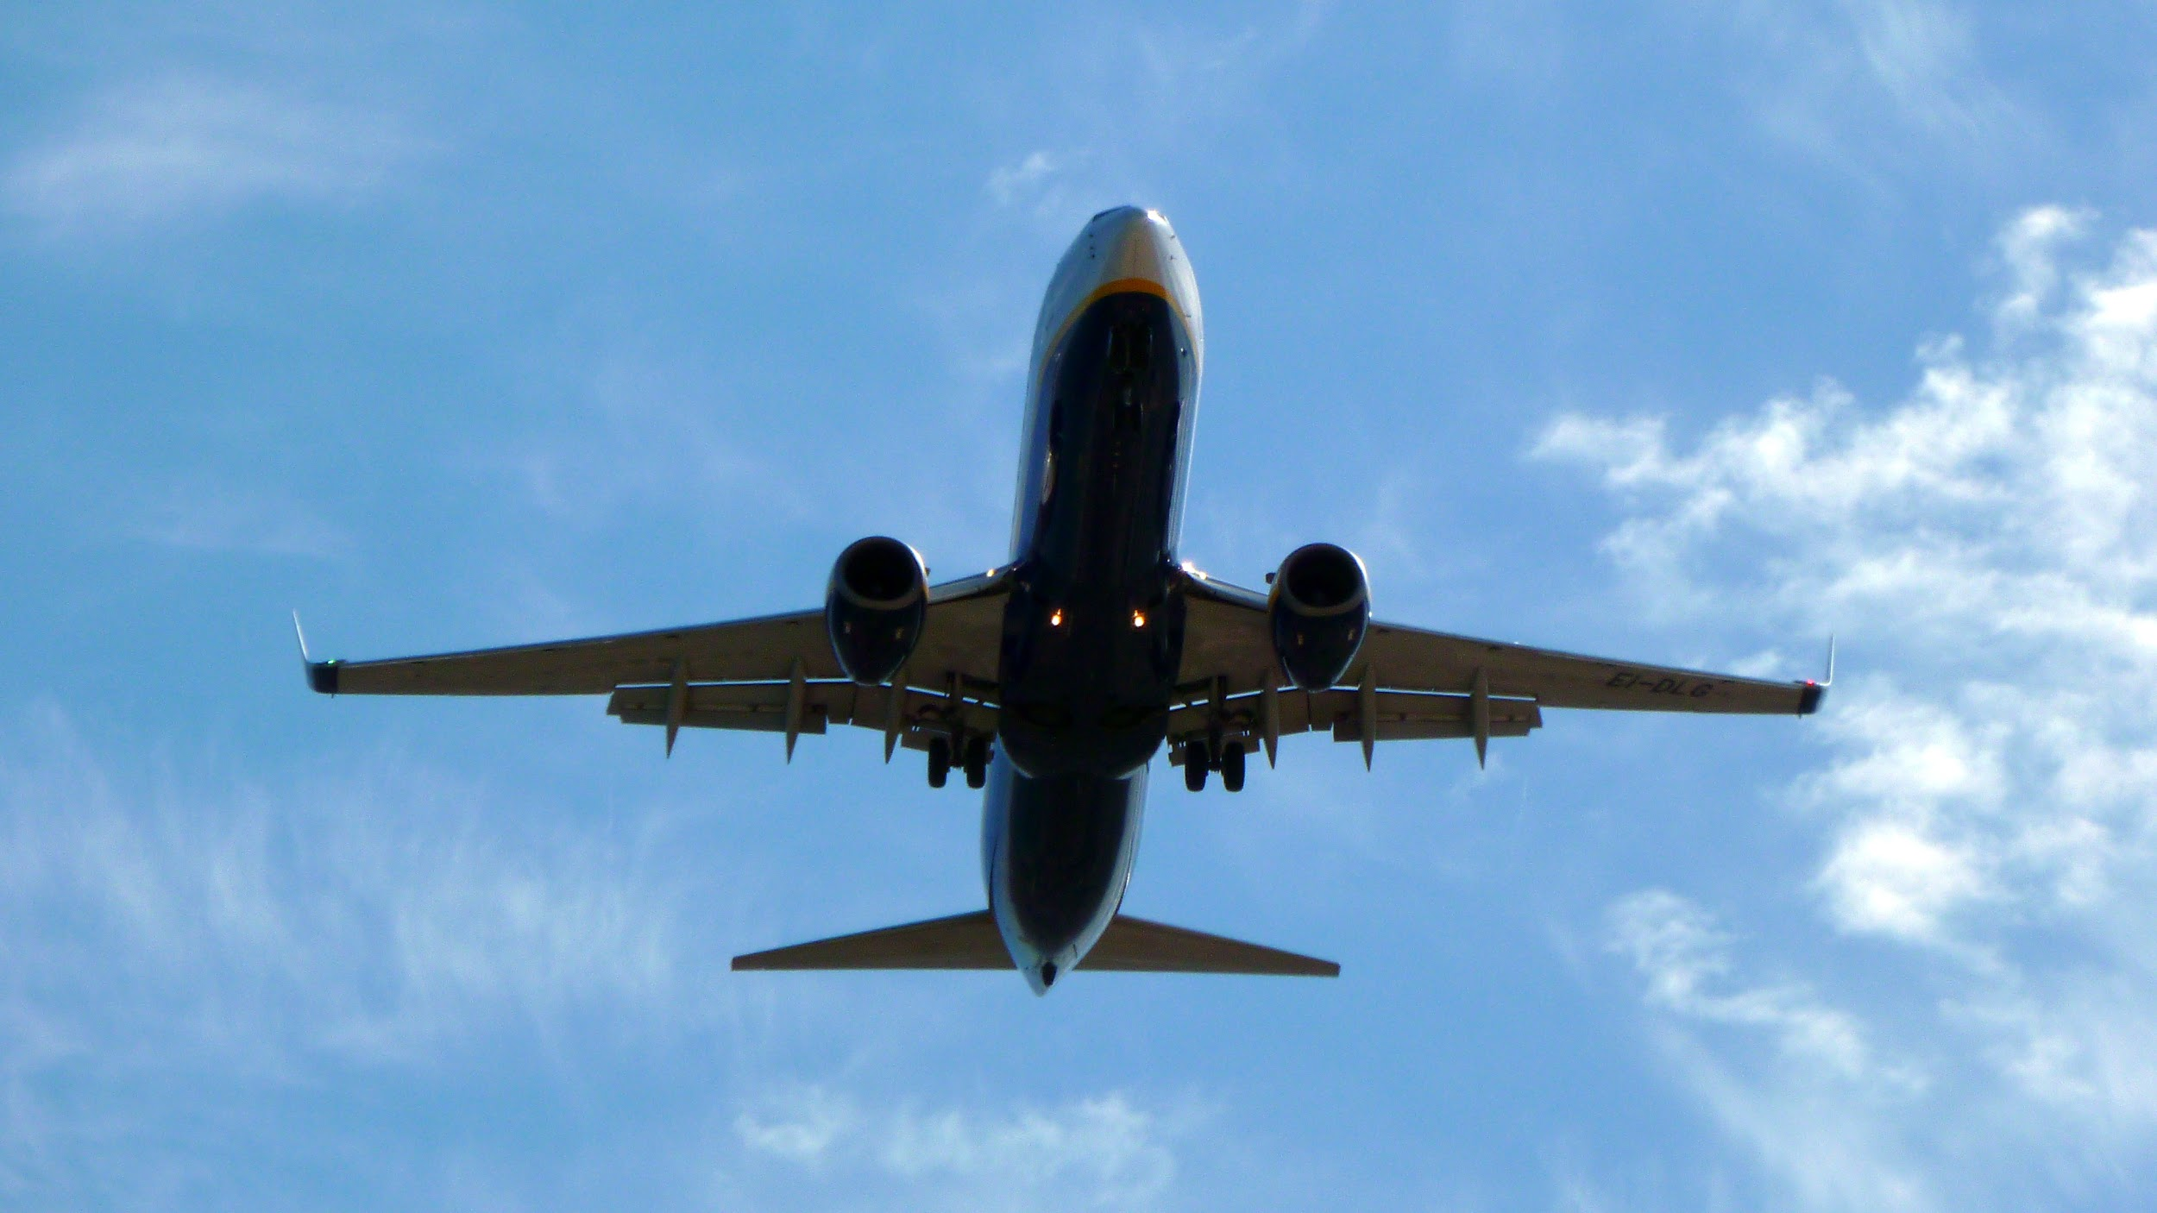
YourOneAirline Safety Presentation
DSC640-T301 Data Presentation and Visualization
Joshua Greenert
3/1/2023
Notes:
My name is Josh Greenert and I’m here today to go over airline safety information, specifically on the behalf of YourOneAirline.

Slide 2

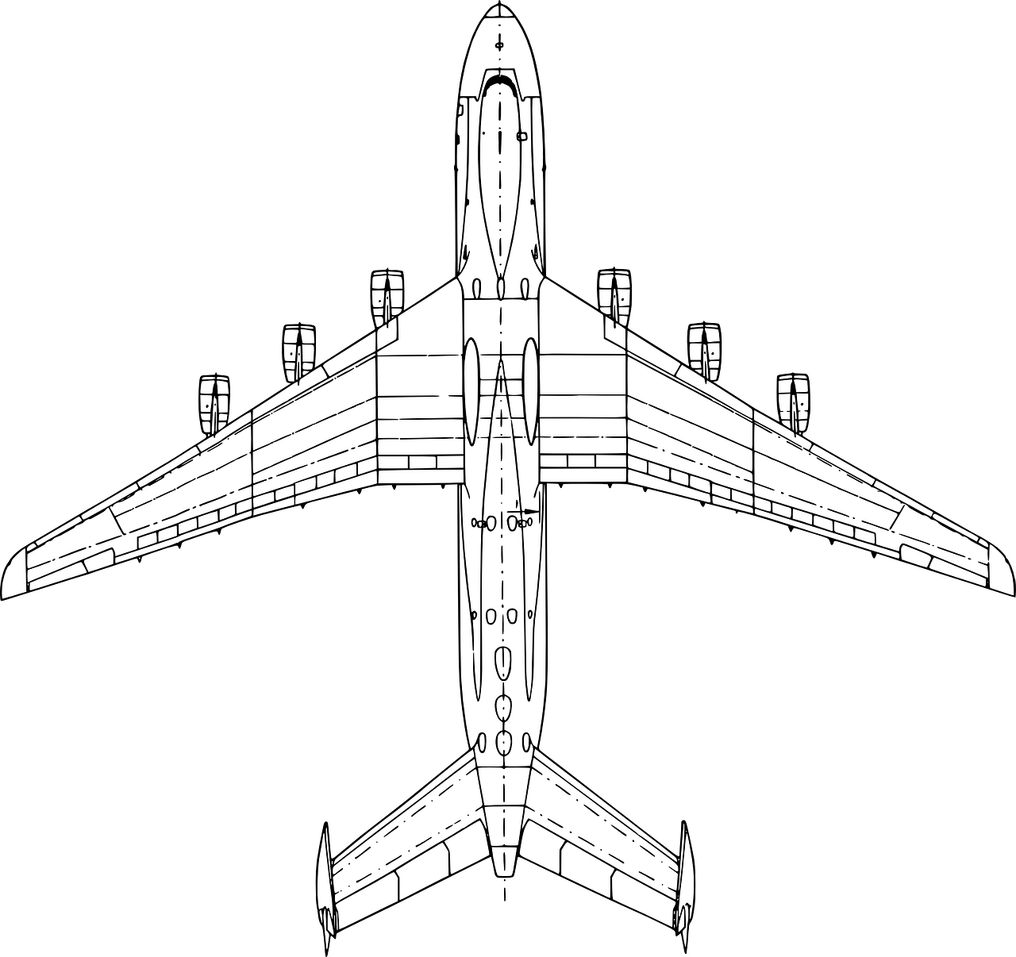
Introduction
Review Airline Safety History
Discuss Recent Data
Concluding Remarks
Notes:
Due to a recent event, the safety of airline travel has been heavily scrutinized. So today I’d like to take some time to cover a bit about the history of airline travel and incidents, discuss more recent data on the current state of airline travel, then provide some closing remarks.

Slide 3

History
1985 - 1999
Notes:
Alright. So the history that we’re about to go over is much further than the accomplishments of the Wright brothers. In essence, the data we’ll be going over today covers a span of 30 years approximately. While we go over this information I want you to think about where the world was then verses where it is currently.

Slide 4
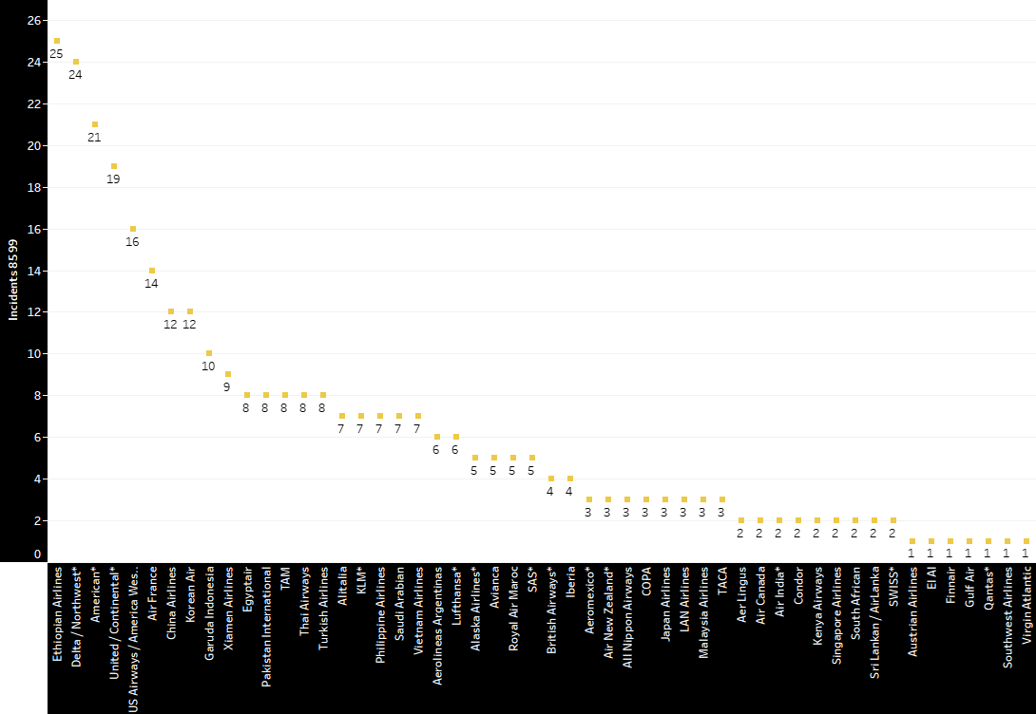
Airline Incidents 1985 - 1999
Notes:
For example, if we look at the graph above, we can see the number of incidents per airline between 1985 to 1999. This 15-year span covers a global view of the amount of incidents that took place back when seat belts weren’t required by state law in cars, and everyone went to work regardless if they were sick.

Slide 5
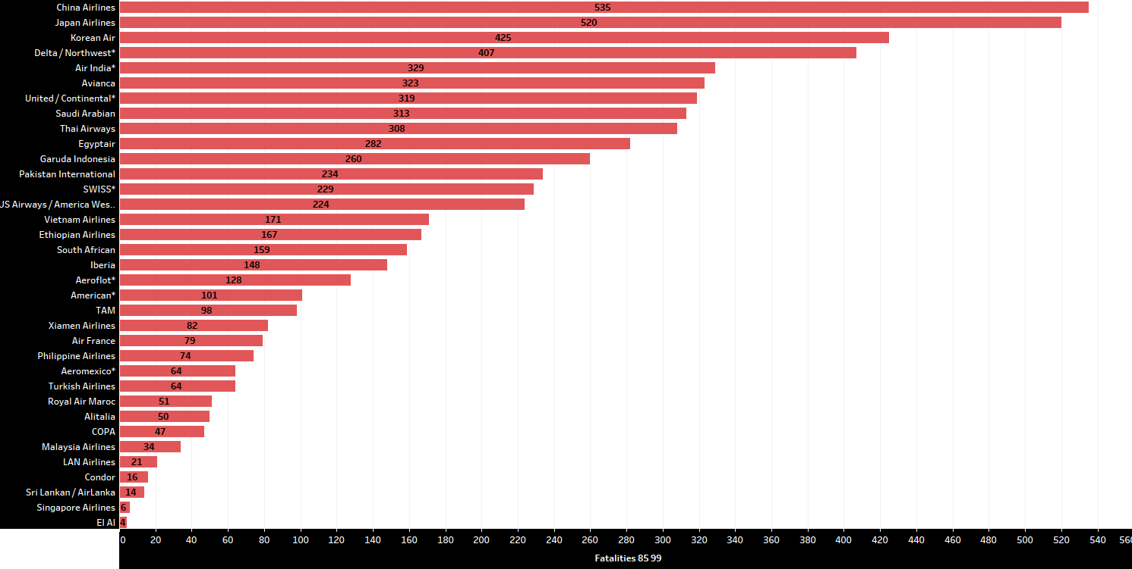
Airline Fatalities 1985 - 1999
Notes:
With a similar line of thinking, we can see airline fatalities were much higher back then too. Specifically, I’d like to mention that the audience take note of the amount of airlines with over 224 deaths from the graph above. About 50% in a 15-year time period.

Slide 6

More Recent Data
2000- 2014
Notes:
Now let’s look at some more recent data. Companies such as ours review this type of data and make significant changes to the processes, strategies, and safety regulations to ensure the utmost safety and security for our passengers and our staff.

Slide 7
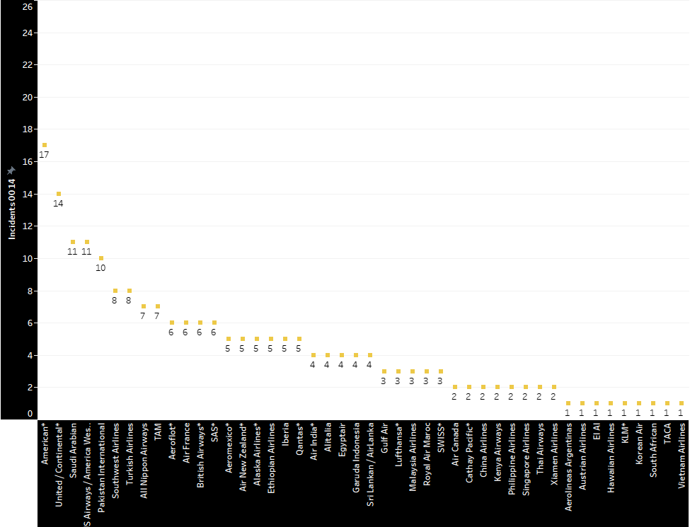
Airline Incidents 2000 - 2014
Notes:
Immediately we can see some improvement in the next 15-year range. Not only do we see less incidents, but we also see fewer airlines displayed on the list.

Slide 8
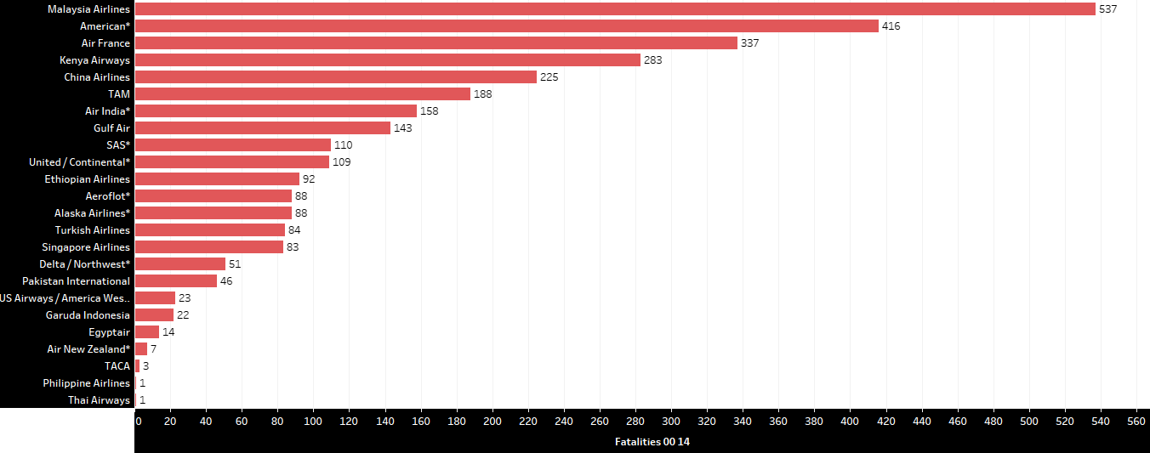
Airline Fatalities 2000 - 2014
Notes:
Likewise, we see that fatalities have dropped substantially where the incidents that occurred previously had less fatalities related because of the safety precautions that were introduced to passengers with every flight.

Slide 9

Closing Remarks
Notes:
Accidents may still continue to happen. However, with our continuing advances in technology, safety and automation, we can reduce that number further with every passing day to ensure the security of our family and loved ones to reach their destination without worry.

Slide 10
References
Airline Safety. (n.d.). Www.kaggle.com. Retrieved March 4, 2023, from https://www.kaggle.com/datasets/danoozy44/airline-safety
https://aviation-safety.net/
Notes:
Finally, for full transparency, we’ve taken the liberty to provide you the source for the data we used to create our visualizations as well as where to find updated airline information generally. We implore you to perform your own research and, hopefully, that leads you on your next travel destination with YourOneAirline.

Slide 11
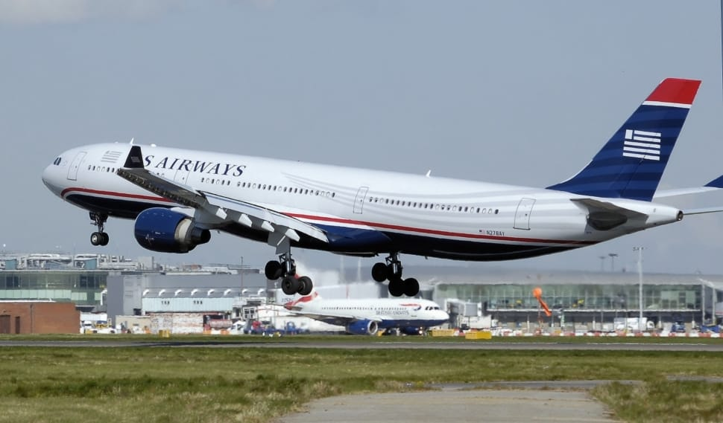
YourOneAirline
Notes:
Thank you for coming and we hope to see you soon!

